Slide 1
Basic concept of real time computing
Yu Qi

Slide 2
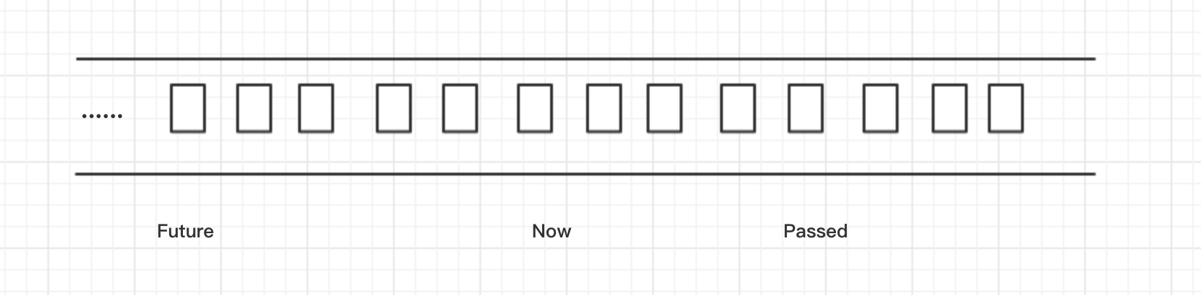
Stream and Batch
Stream
Unbound, moving
Notes:
想像不会断水的自来水管
支持回放

Slide 3
Batch
bound, static
Notes:
常见的数据
数据库
文件系统等数据

Slide 4
Stream and batch
Stream
Unbounded.
Real Time. Log data, monitor data, screen, Message
Time related
Batch
Bound and will not change
Huge size

Slide 5
Scene
Why total sum is changing according time and we can get the current number exactly ?

Slide 6
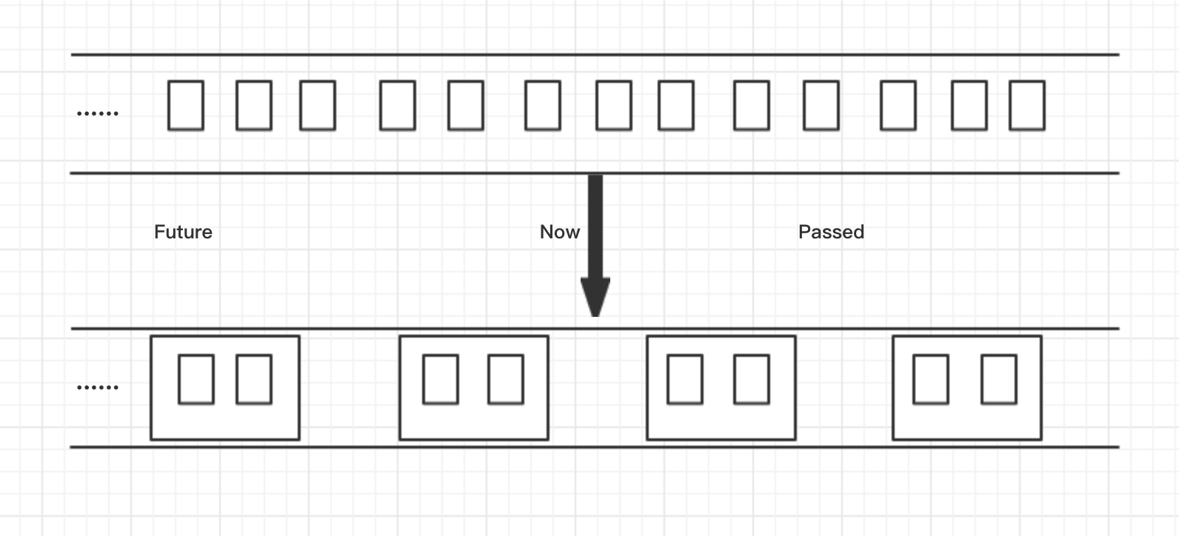
How to compute stream?
Stream to batch
Notes:
流批化，如下图， 如何对无穷的数据进行计算，比如说我算一个sum的数据
1 + 2 + 3 。。。。
由于数据无界，总不能

Slide 7
Window
Split to window
Kind
Time based Window
Record Size based Window
Notes:
而在流中 实际上用将window来定义类似批的概念
基于Time的window是以time来划分窗口

Slide 8
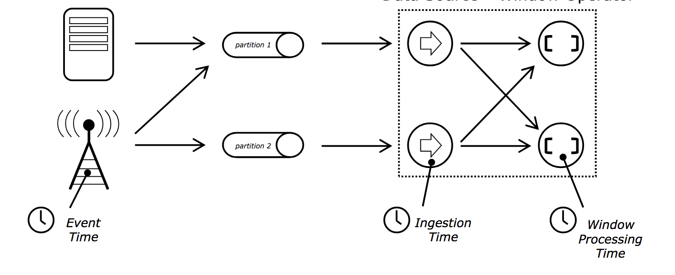
Time in stream
Event Time
Ingestion Time
Processing Time

Slide 9
Model
Fact: in real word, procesing time always lag behand the event time, see picture right
Target: reduce the time gap between processing time and event time
Why call real time computing
ProcessTime – EventTime ~ 0

Slide 10
Window
Sliding Window [9:00, 10:00], [9:30, 10:30]
Session Window
mysql connection
Global Window
all element belongs to a single window
Fixed Size Window
[9:00, 10:00], [10:00, 11:30]

Slide 11
Window example

Slide 12
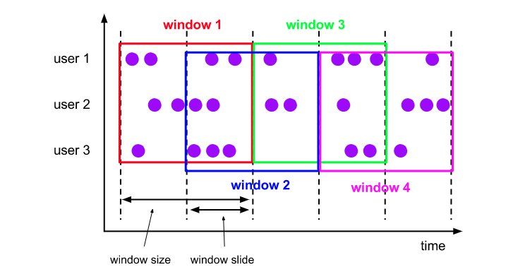
Sliding Window
Count the element number in a hour every 30m

Slide 13
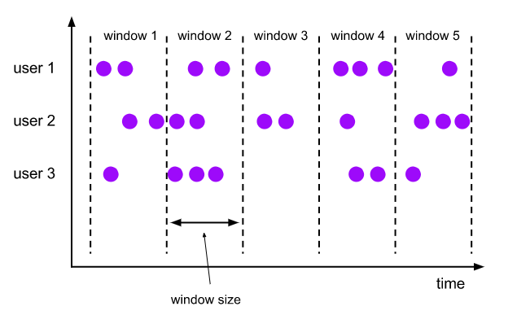
Fixed-size Window
Compute the number of visitor in every hour

Slide 14
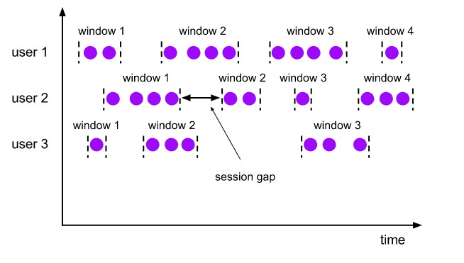
Session Window
In MySQL, compute count of query in a single long connection with timeout of 30s
In a login Session, collect all users action

Slide 15
Trigger
Why: to invoke window function to compute
When:
1. Process Time/ Ingestion Time
End time of Window && Records exists
2. Event time
WaterMark great than End time of Window

Slide 16
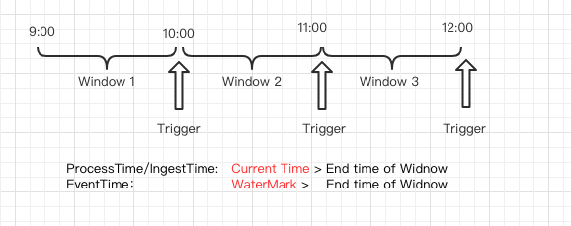
Example

Slide 17
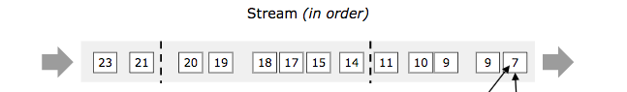
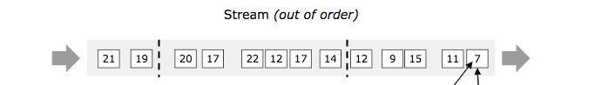
Event Time Problem
Out of order Problem

Slide 18
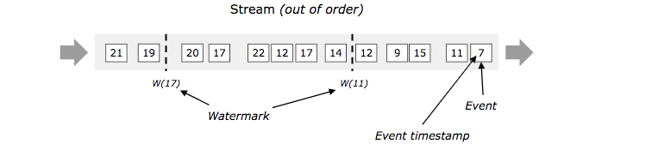
WaterMark
For a watermark of timestamp t, it mean there is no record with timestamp t1 that greater than t
WaterMark can not issure 100% correctness
Heuristic watermark && perfect watermark

Slide 19
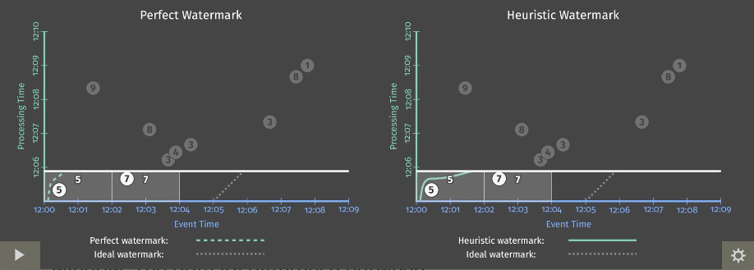
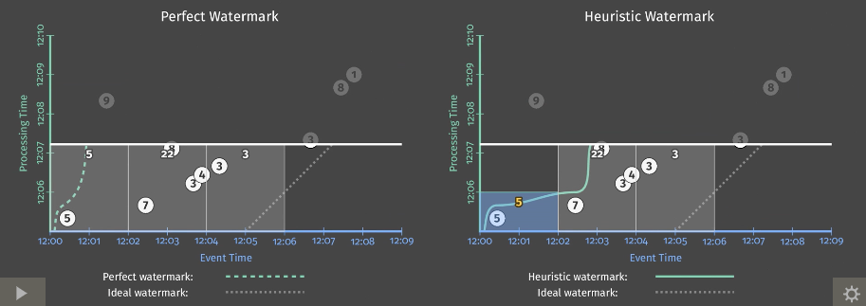
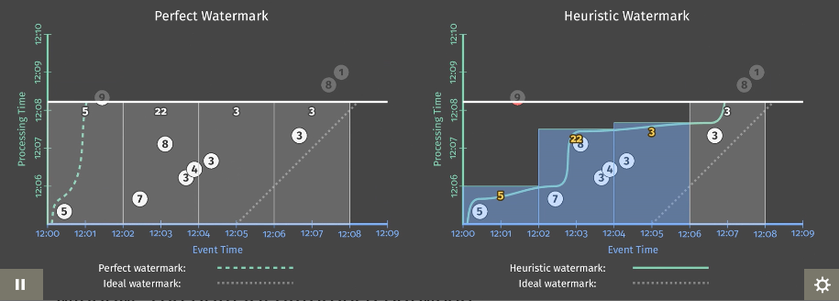
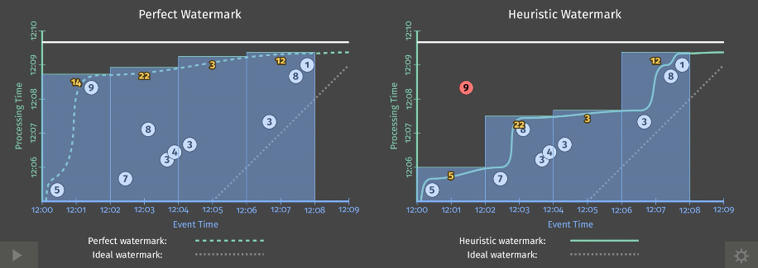
WaterMark example

Slide 20
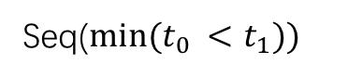
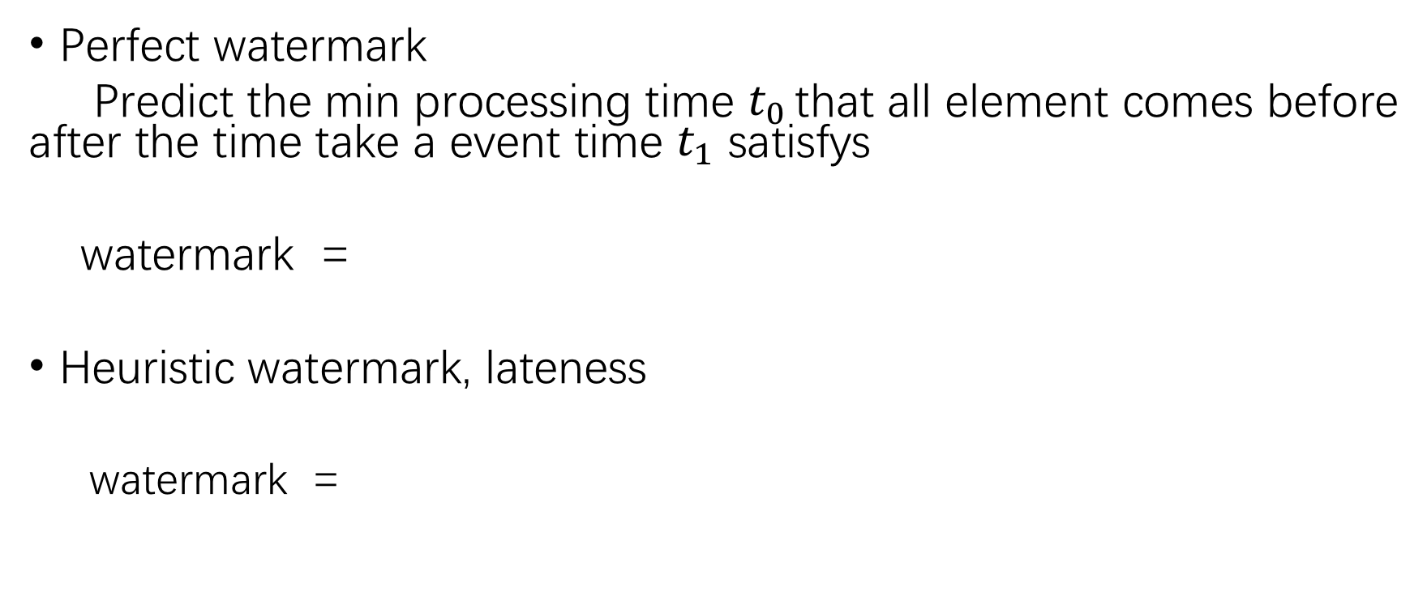
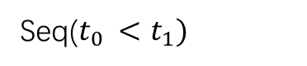
Perfect watermark
Predict the min processing time $t_{0 }$that all element comes before after the time take a event time $t_{1}$ satisfys
watermark =
Heuristic watermark, lateness
watermark =
Seq($min⁡(t_{0 }<t_{1}))$
Seq($t_{0 }<t_{1})$

Slide 21
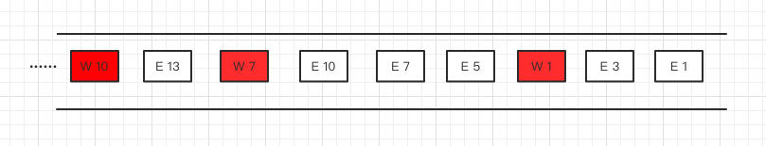
How to implement WaterMark
WaterMark invoke Trigger
WaterMark is treat as normal Record

Slide 22
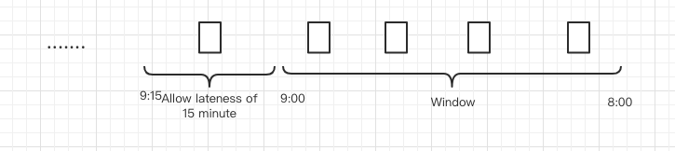
Allow lateness
To handle element that comes after the end edge of window
After lateness, the whole window will be clear if needed
Event-Time based
Drop element if lafter than the lateness time

Slide 23
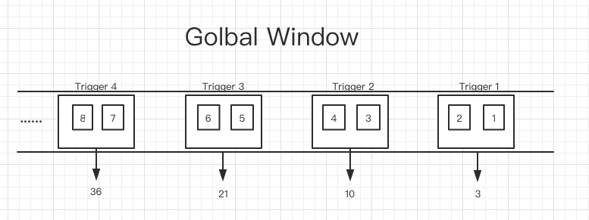
Retraction
Output of each trigger: 3, 10, 21, 36, but is this is expected ?

Slide 24
Problem and Solve
Input | Output
1
2 | 3
3
4 | -3 10
5
6 | -10 21
7
8 | -21 36
Input | Output
1
2 | 3
3
4 | 10
5
6 | 21
7
8 | 36

Slide 25
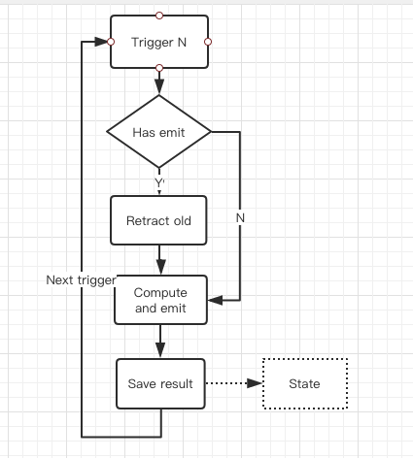
Implementing
Trigger n and the next trigger n+1
When Trigger n, if have state, first retract the old result and then emit the the new one
When Trigger n+1, retract the result of trigger n and emit the result of n+1

Slide 26
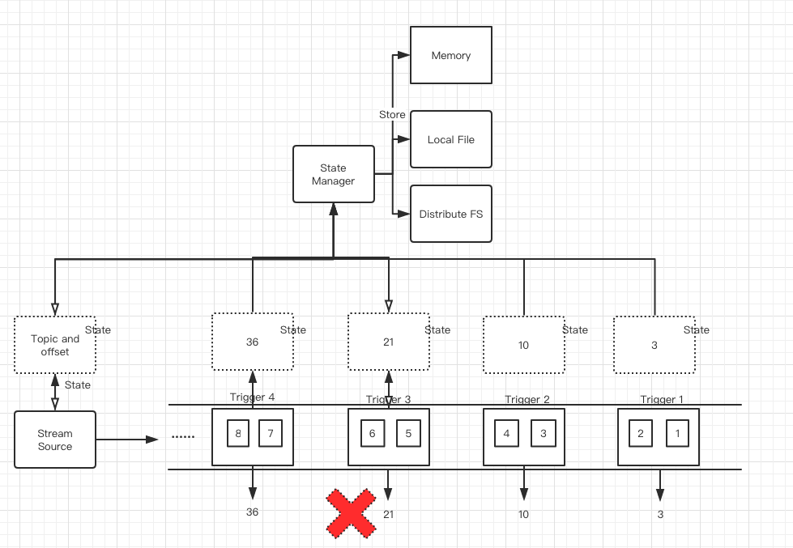
State and fault tolerance
Keep the state/snapshot/checkpoint of stateful operator , middle result and other information needed to recovery task

Slide 27
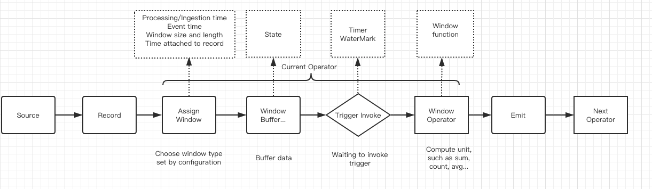
Summary

Slide 28
Stream Compute Platform
Storm
Flink
Kafka streaming
Spark streaming
Dataflow
…

Slide 29
Thank you ~

